Slide 1



Augmented Reality Sandbox Using the Kinect 2.0 SDK, WPF, Unity, Prism, and MVVM practices to build something fun
Matthew Thomas
Software Engineer
Sept 8, 2015

Slide 2





About Matthew
Notes:
So a little bit about me; I grew up in a small town in Illinois, just east of Saint Louis Missouri

Slide 3





Notes:
And then around 2011, I had the opportunity to move to the great state of Texas. Unfortunately, the opportunity that brought me here only lasted about 6 months, and not wanting to go back I began my career here, first as a contractor at USAA, and then as a contractor at Capital Group, where I presently work

Slide 4

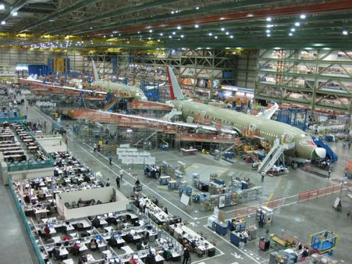


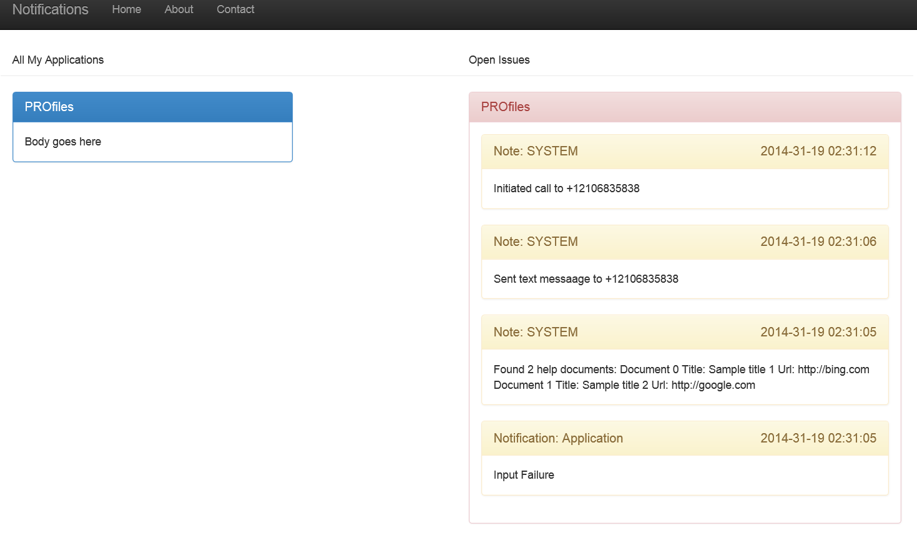
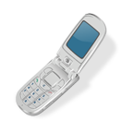

Augmented Reality Sandbox Why?
PRL
Notes:
So why did I even go about doing this? Well, I had an opportunity to talk at my kid's career day, and I was trying to think about all the "big" projects I've done over the course of my career:
Wait time estimation for the Air Force,
A data collection application for Boeing's mechanics to use when repairing aircraft
A job evaluation tool for USAA's managers
and an automated batch notification system for USAA's batch process
And I thought, what do these all have in common - and more importantly, how do I explain that to 5 and 6 year olds in a way that'll be interesting?

Slide 5


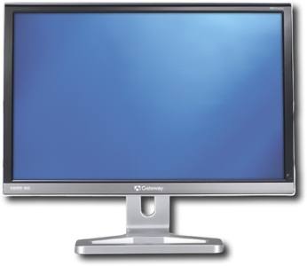


Notes:
And it all really comes down to the following:
I work in an industry where
- I take data
- I run it through a process
- And I make it usable for people

Slide 6
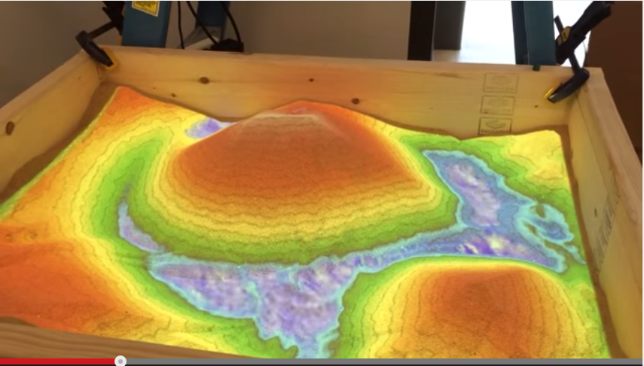
OMG I CAN TOTALLY BUILD THAT!
Notes:
So as I'm looking around, for some data visualization projects, I come across this YouTube video, and I see this sandbox that changes colors when you dig in it.
And I had the idea that so many of us have had when we see something cool
OMG I can totally build that!

Slide 7
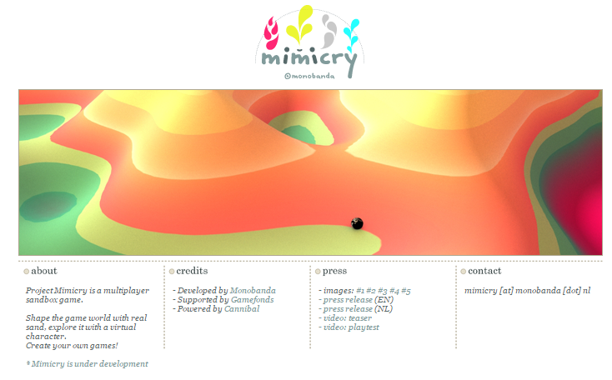

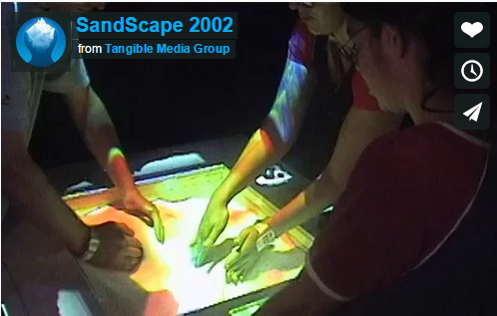

iSandBox: Can’t buy just the software;
Expensive shipping of entire project
from Russia
Mimicry: Perpetual development;
Emails go without answer to somewhere
in the Netherlands
SandyStation: No information on build;
Emails go without answer to somewhere
in the Czech Republic
SandScape: Abandoned?
Requires a $40,000 camera
Notes:
So it turns out that there's a lot of projects that do Augmented Reality sandboxes - most of them though, are not viable for one reason or another

Slide 8
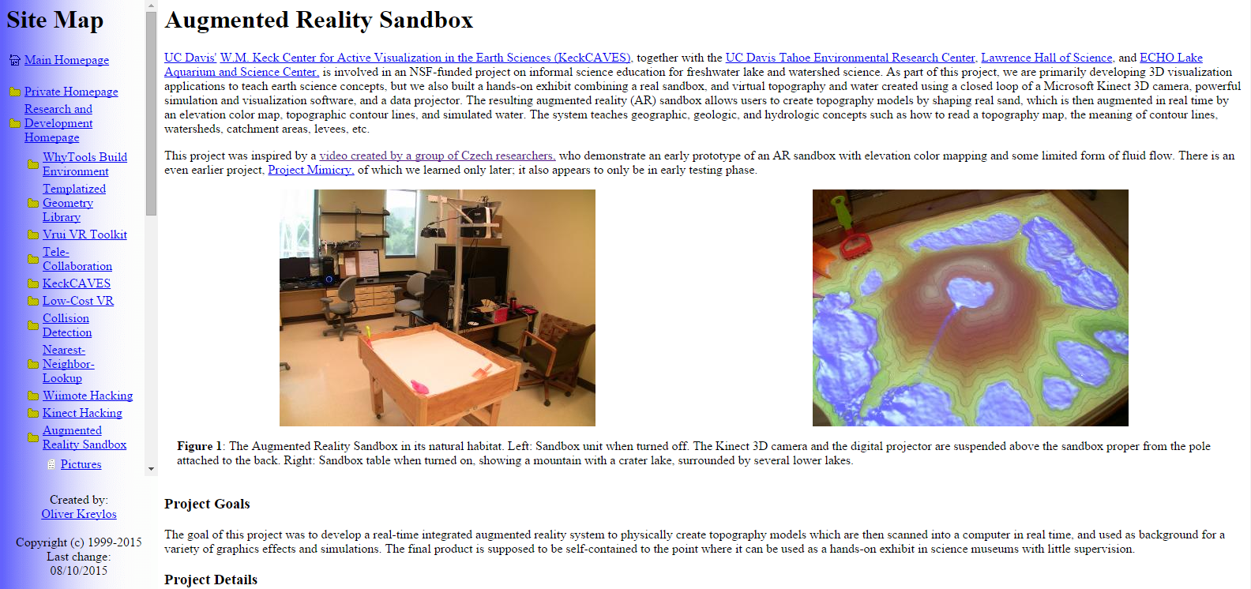
UC Davis SARndBox
Notes:
And then I found this project out at UC Davis, and it was exactly what I was looking for

Slide 9
UC Davis SARndBox
Pros:
It’s already written, and tested
Lots of documentation
Several YouTube videos of completed installations
Cool water animation feature

Slide 10
UC Davis SARndBox
Cons:
Requires Xbox 360 Kinect Camera
Very specific graphics card requirements
Very specific processor requirements
Very specific RAM and hard drive requirements
Very specific driver requirements
some of which don’t come from “official” sources
“Any” version of Linux

Slide 11
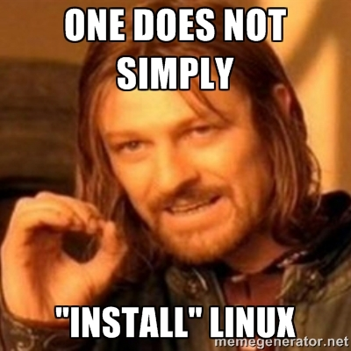

Slide 12
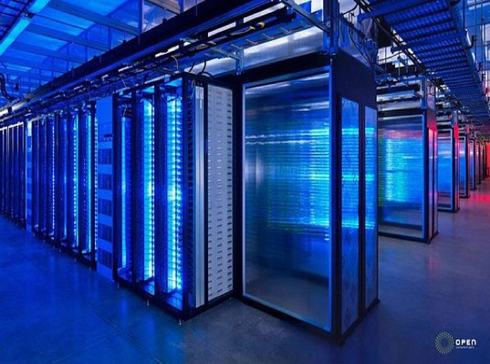
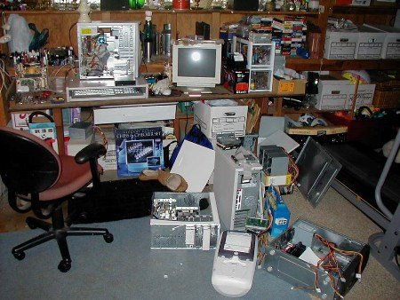
Advertised Linux installation
Actual Linux installation
* In my personal experience

Slide 13
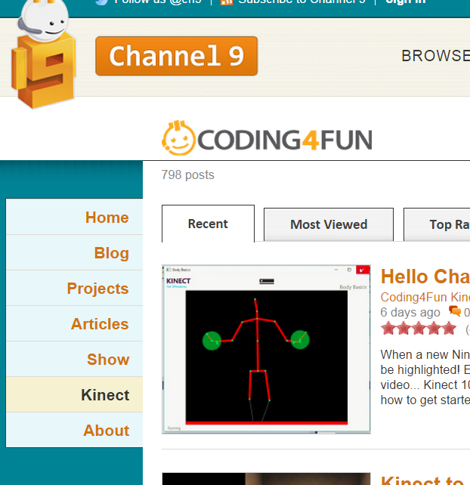
Notes:
I really wanted to use the Kinect camera for the XBox One, and I saw all of these projects that used Kinect for XBox one, and so I thought, "how hard could this be?"

Slide 14
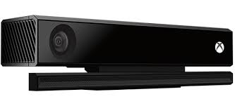
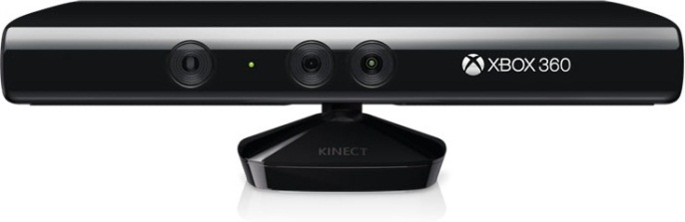
Feature | Kinect for Xbox 360 | Kinect for Xbox One
SDK Release Date | Feb 21, 2011 | July 15, 2014
Color Camera | 640 x 480 @30 fps (SD) | 1920 x 1080 @ 30fps (HD)
Depth Camera | 320 x 240 | 512 x 424
Max Depth | ~4.5M | ~4.5 M
Horizontal field of view | 57 degrees | 70 degrees
Vertical field of view | 43 degrees | 60 degrees
Tilt motor | Yes | No
USB Standard | 2.0 | 3.0

Slide 15
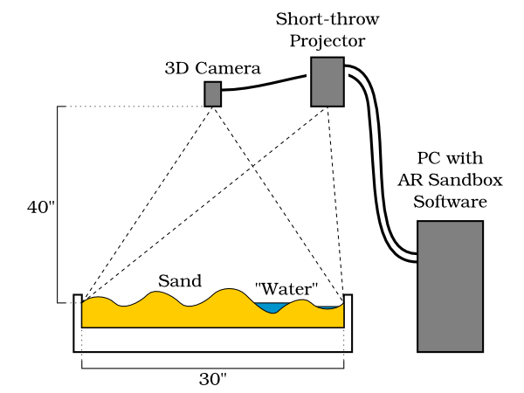
Hardware
Notes:
The sandbox should have a 16x9 ratio, since this is the same ratio of the depth sensor on the Kinect camera

Slide 16
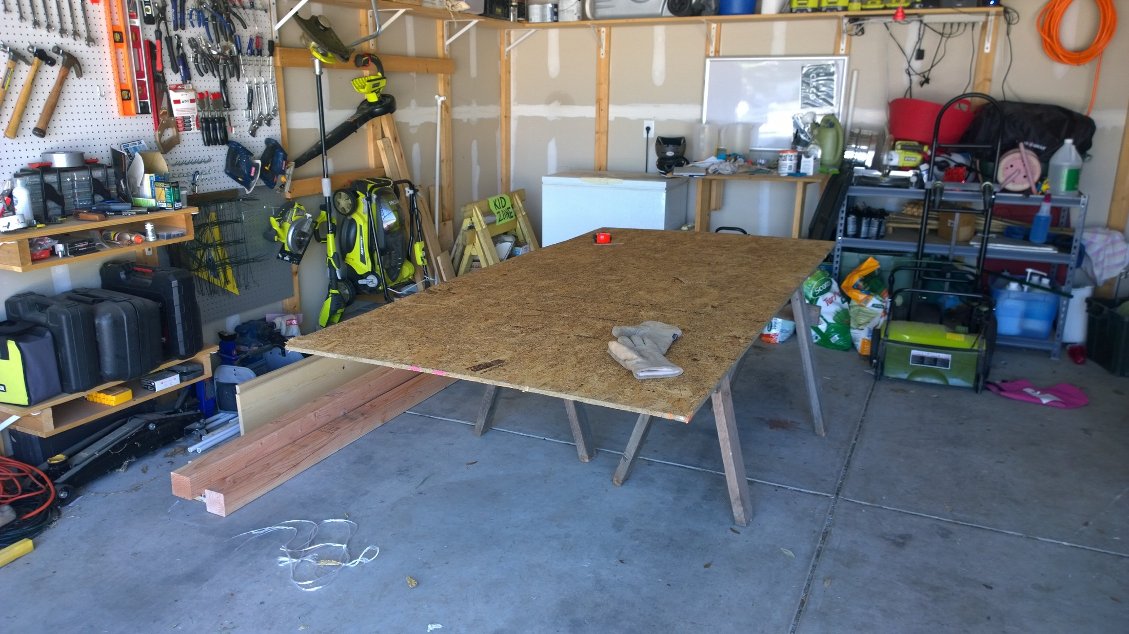

Slide 17
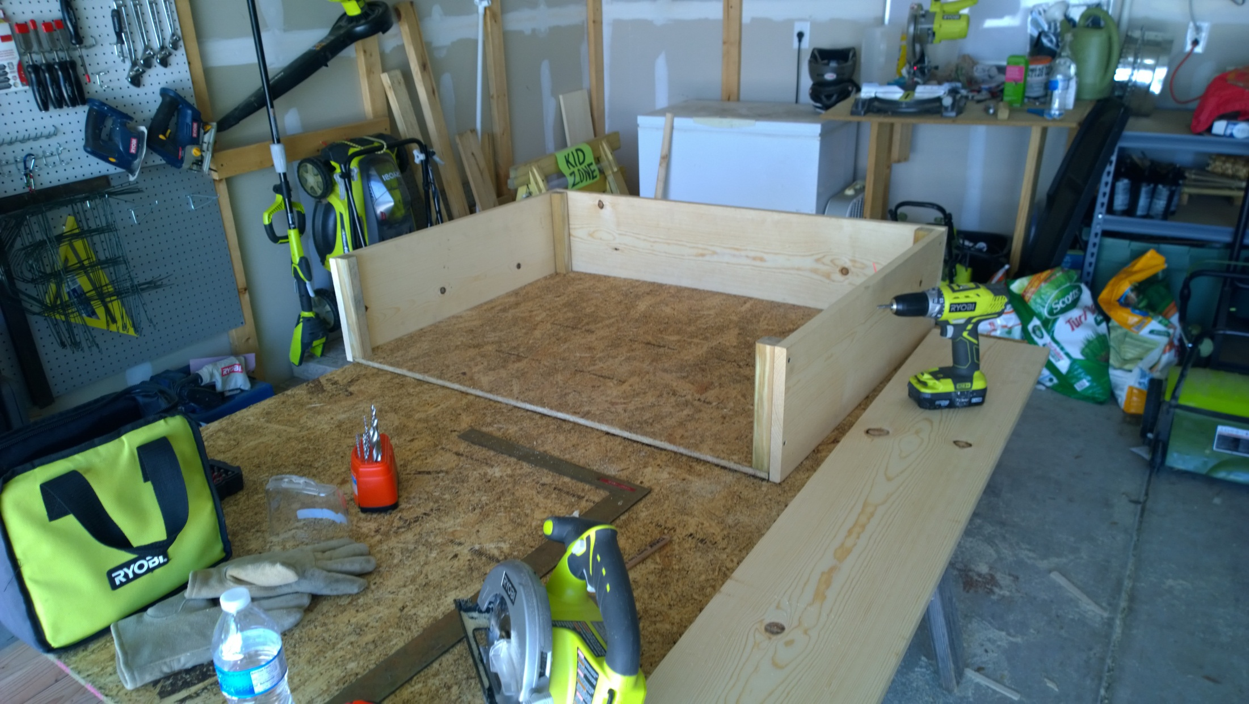

Slide 18
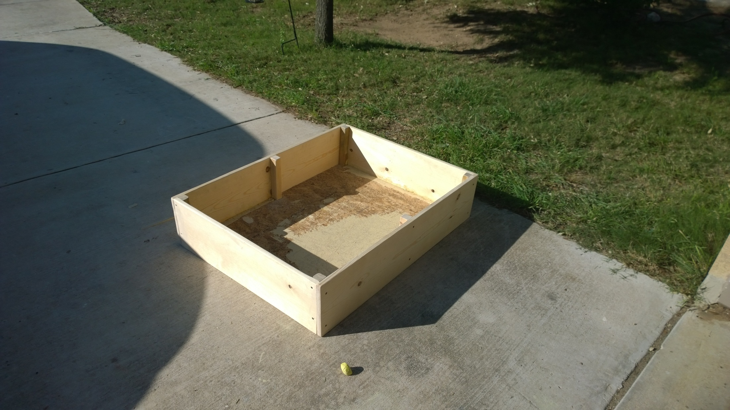

Slide 19
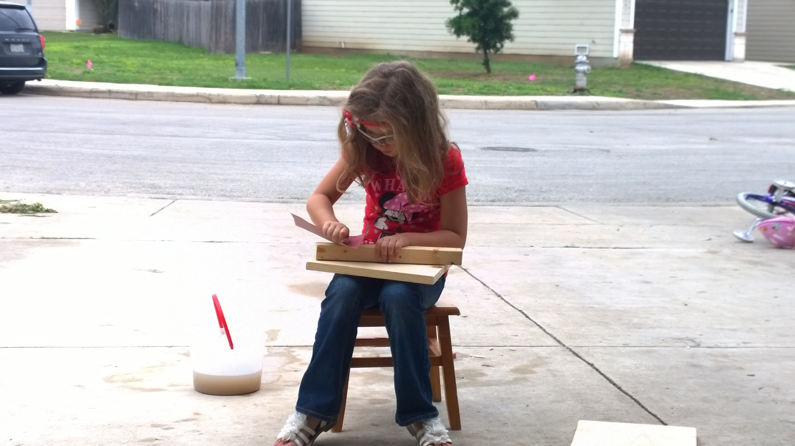

Slide 20
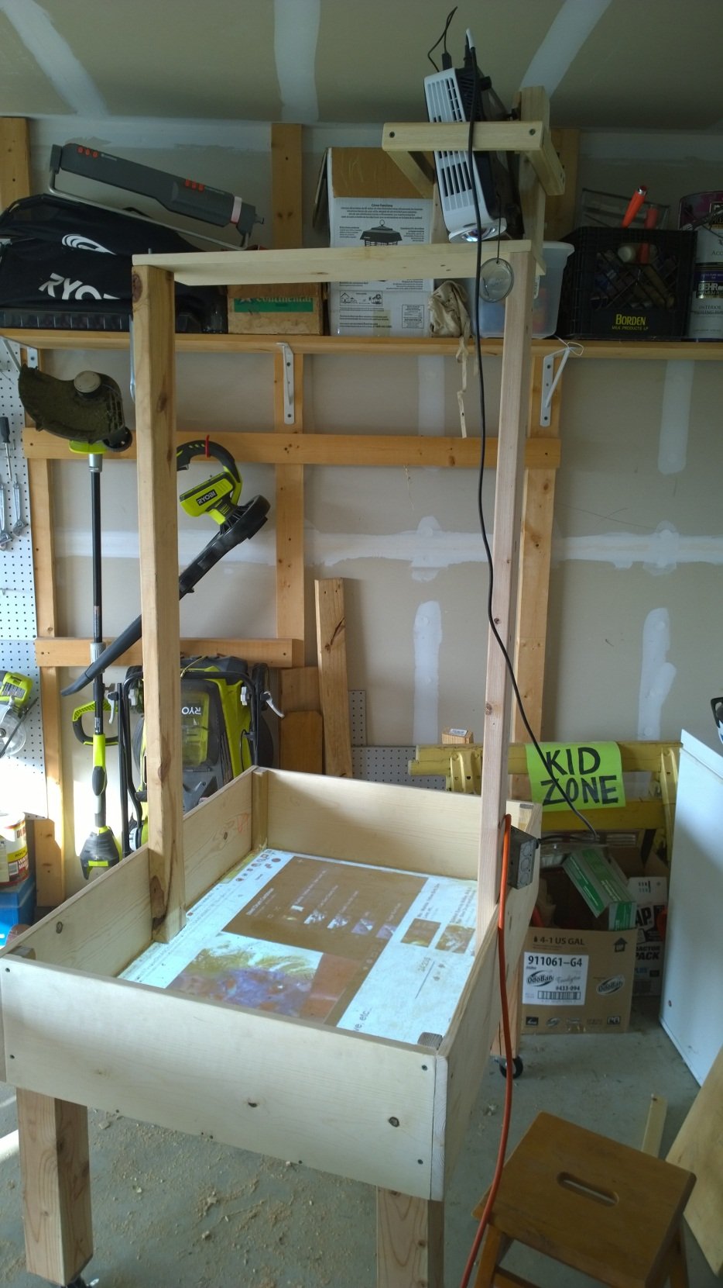

Slide 21


